Slide 1
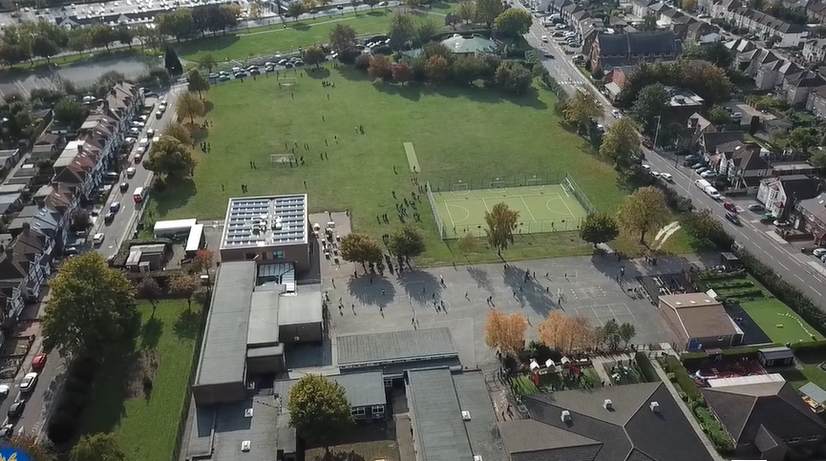
Parent Curriculum Meeting Reception January 2024

Slide 2
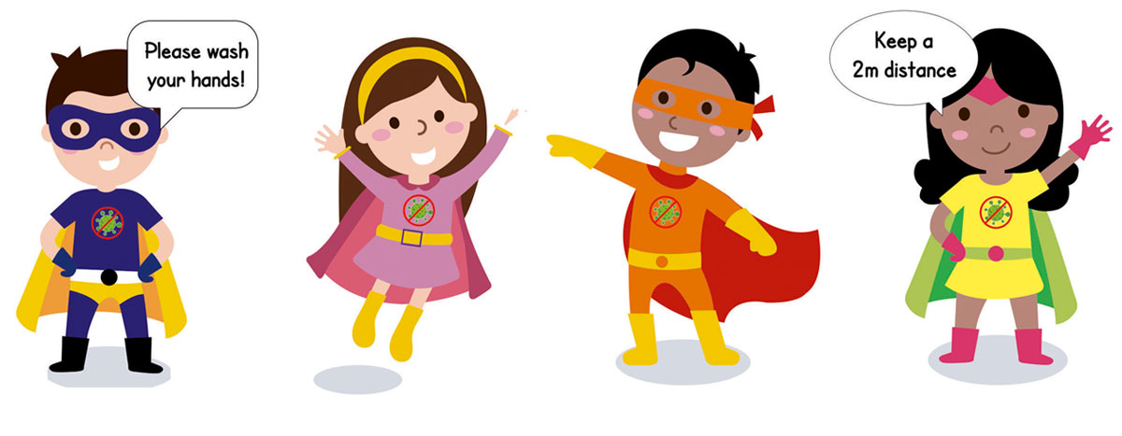
School Vision and Motto
At Barley Lane Primary School it is important that we all work together to ensure that everyone feels happy, safe and ready to learn.
Our School Motto
Believe in yourself, Learn together, Persevere and Succeed

Slide 3
Information Outline
1. Welcome
2. Spring Curriculum Topics and Big Question
3. Literacy/Phonics
4. Maths
5. Other areas of Learning
6. Questions

Slide 4
Spring Curriculum Topics
Summer Topic:
Around the World (Spring 1) People Who help us (Spring 2)
Big Question:
Where are we from? (Spring 1)
How do people help us in our community? (Spring 2)
Notes:
Office.Admin: sending out letters, building and analysing surveys, answering queries, advising ov everchanging guidance and answering emails and phone calls
Premises staff: working tirelessly mornings, afternoons, evenings to create safe bubbles, signage, cleaning
LTAs working via zoom with their children, taking resources home to prepare, joining in on zooms
Catering staff: on furlough, Bal agreeing to come in
Fellow SLT: managing remote learning, staff welfare, keeping up with guidance

Slide 5
EYFS Curriculum
Prime areas
Personal, Social and Emotional development
Communication and language
Physical Development
Specific areas
Literacy
Mathematics
Understanding the world
Expressive arts and design

Slide 6
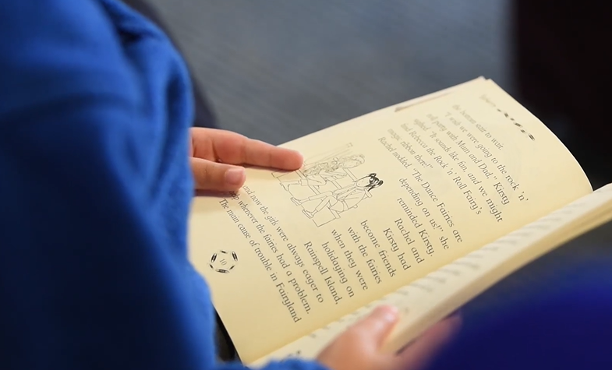
Literacy/ Communication and Language
Literacy
Our key text this term is ‘Anna Hibiscus’ song’. This links with our topic ‘Around the World’ as well as other areas of the curriculum such as PSED, Communication Language and Literacy, and Understanding of the World.
Through this text, children will be taught many reading skills such as making predictions, making inferences, retelling, clarifying meanings of words and asking and answering questions.
Cursive name writing and weekly handwriting practice
Form lowercase and capital letters correctly.
Spell words by identifying the sounds and then writing the sound with letter/s.
Write short sentences with words with known sound-letter correspondences using a capital letter and full stop.
Re-read what they have written to check that it makes sense.
Communication and Language
Listening
Understanding and responding appropriately
Speaking skills (having conversations in full sentences)
Turn-taking

Slide 7
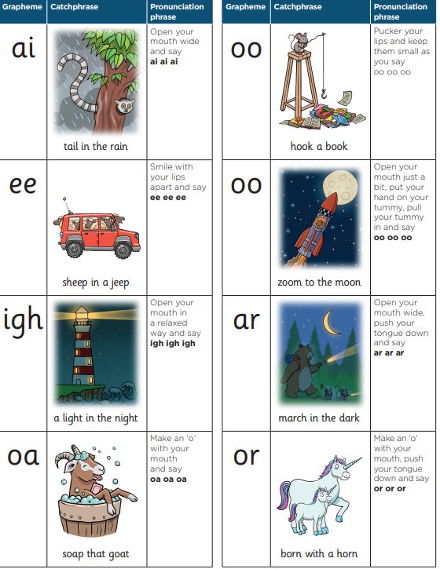
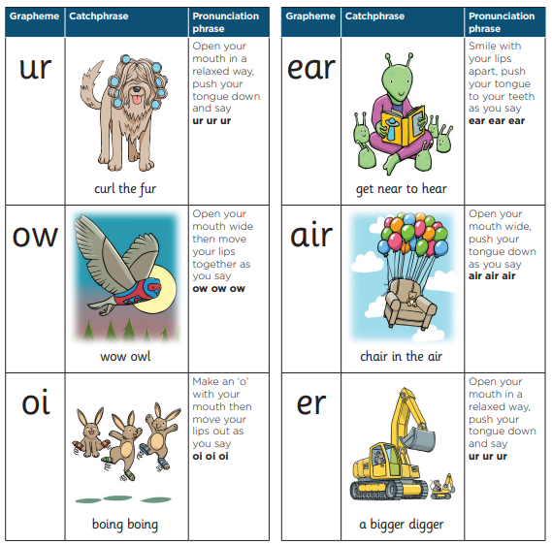
Phonics
Phonics is a way of teaching children how to read and write.
Teaches children to blend the sounds (phonemes) of letters (grapheme) together to read unfamiliar words.
Children are expected to read a range of common words fluently by the end of Reception
Website Links
https://www.littlewandlelettersandsounds.org.uk/resources/for-parents/
Children have phonics lesson every day from 9-9.30
https://www.youtube.com/results?search_query=mr+thorne+letter+sounds

Slide 8
Reading
Children will be given a stage book based on their reading and comprehension ability. These books will be changed weekly and we recommend you read or listen to your child read at least for 10 minutes a day.
Reading challenge
Children who read 3 times a week and a comment is written in their reading record will receive a sticker for their chart.
Oxford Reading Tree - https://www.oxfordowl.co.uk

Slide 9
Reading
How to hear your child read.
Choose a time that best suits you and your child.
Choose a quiet comfortable place Only keep going for as long as you are both enjoying it. Take turns with the reading
Help them when they get stuck
Talk about the pictures and the story
Give your child lots of praise and encouragement

Slide 10
Communication and Language
Use talk to help work out problems and organise thinking and
activities, and to explain how things work and why they might happen.
Engage in story times
Listen to and talk about stories to build familiarity and understanding.
Retell the story, once they have developed a deep familiarity with the
Use new vocabulary in different contexts.
Listen to and talk about selected non-fiction to develop a deep

Slide 11
Communication and Language
Class Teddy
Every Friday one child will be chosen to take the ‘Class Teddy’ home for the weekend.
We choose to do this as a fun way to develop confidence when speaking and listening to others. It also helps children to practise their writing, reading, phonics and drawing skills.
Parents can also use the teddy to share a moment with their child, whether you’re making up a story, reading a book, or using that teddy to talk about emotions or feelings.
Activities to do at home with the class teddy:
Cooking
Cleaning
Bathing
Brushing teeth
Shopping
Visiting relatives/friends house
Reading a story
Playing games
Please encourage your child to draw/take pictures of activities taken place with the ‘Class Teddy’ and write a simple sentence/words/initial sounds to go with it.
Class teddy needs to be returned back to class on Monday.
Children will have the opportunity to share the ‘Class Teddy’s’ journal with the class and talk about what they did.

Slide 12
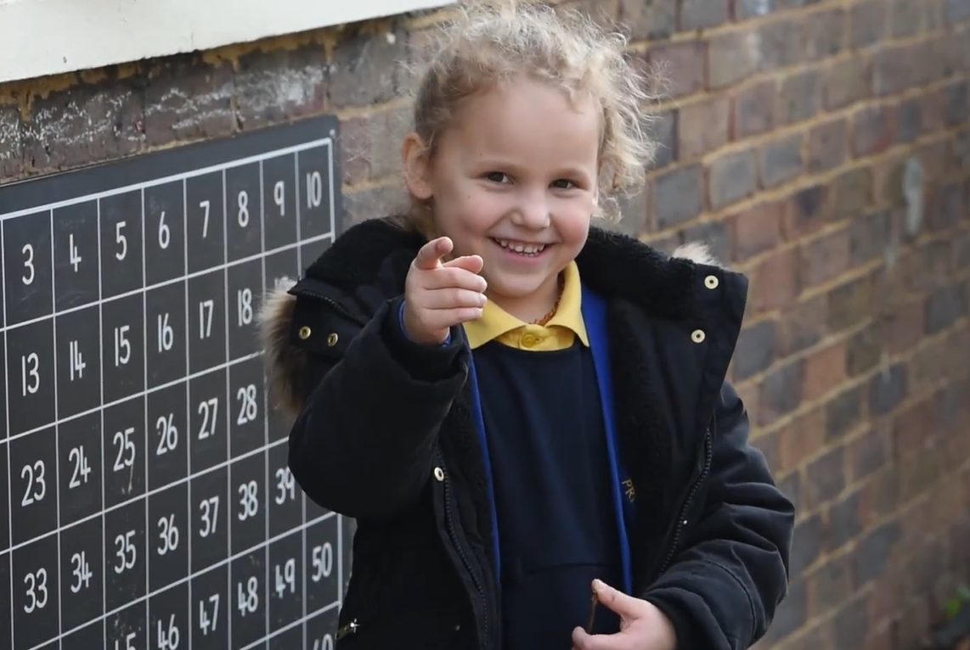
Maths
Maths
We follow a well-known Maths programme called White Rose Maths Hub
White Rose Maths Hub full programme is available here: https://whiterosemaths.com/resources/early-years-resources/reception- sol/
This half term we will be focusing on matching, sorting, comparing amounts and 1-1 counting:
Term 1
Introduce zero
Find 0 to 5
Subitise 0 to 5
Represent 0 to 5 1 more
1 less
Composition
Conceptual subitising to 5 Compare mass
Find a balance
Explore capacity
Compare capacity
Find 6, 7 and 8
2 Represent 6, 7 and 8
1 more
1 less
Composition of 6, 7 and 8Make pairs – odd and even
Double to 8 (find a double)
Double to 8 (make a double)
9 Combine two groups
Conceptual subitising
Explore length
Compare length
Explore height
Term 2
Compare height Talk about time
Order and sequence time
Find 9 and 10
Compare numbers to 10
Represent 9 and 10
Conceptual subitising to 10
Make arrangements of 10
Bonds to 10 (3 parts)
Doubles to 10 (find a double)
2 Doubles to 10 (make a double)
Explore even and odd
Recognise and name 3-D shapes
Find 2-D shapes within 3-D shapes Use 3-D shapes for tasks
3-D shapes in the environment
Identify more complex patterns
Copy and continue patterns
Patterns in the environment

Slide 13
Maths
Maths at Home
Weighing ingredients when cooking.
Looking at money when shopping.
Numbers on buses, cars, doors etc.
Plan a picnic with your child and let your child decide how many sandwiches and bananas will be needed.
Ask your child to show you a number before we leave for school. Who can find that number?
Sing number songs where you have to count backwards like “Five Little Ducks” or “Ten Fat Sausages”.

Slide 14
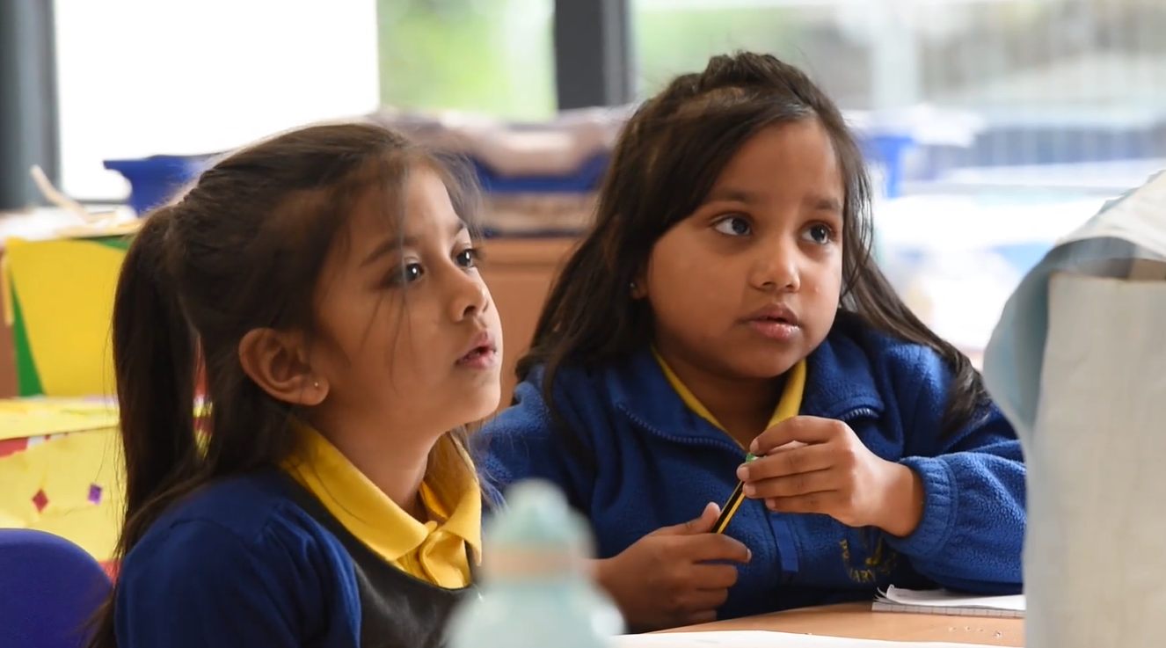
Other areas of Learning
Understanding of the World
Term 1
Using a globe to locate different countries.
England (United Kingdom)
looking at different landmarks, famous buildings, capital cities, food and language
Romania
looking at different landmark, famous buildings, capital cities, food and language Bangladesh
looking at different landmark, famous buildings, capital cities, food and language India
looking at different landmarks, famous buildings, capital cities, food and language
China
looking at different landmarks, famous buildings, capital cities, food and language
Term 2
Learning the emergency number
Creating a people who help us scenes in tuff tray reflective clothing.
Fire safety - Understanding jobs and why they are important to us
Oral hygiene Healthy eating - Understanding jobs and why they are important to us Looking after garden, knowing what a plant needs to live
Zoo lab - Caring for animals
Understanding jobs and why they are important to us
Role play classroom
Understanding jobs and why they are important to us
Planting bulbs

Slide 15
Expressive Art and Design
Other areas of Learning
Term 1
New Year Resolution poster
Famous landmarks- United Kingdom.
England flag
Red buss
Letter box
Using templates, the children will paint, colour and use collage materials to make each flag.
Traditional clothing
Using templates, the children will paint, colour and use collage materials to make traditional clothing.
Traditional food from India
Children to have paper plate and create a food plate from India.
Chinese new year
Dragon art
Collage of lantern
Term 2
Police car
Junk modelling-making emergency vehicles
Fire fighter hats
Making hats.
Use a variety of materials to create a collage ie paints, fabrics, tissue paper
Making teeth and designing toothbrushes using different materials
To make stethoscope using junk modelling
Chn to create their own teacher role model using collage material

Slide 16
Physical Development – Fine Motor, Gross Motor
PE days – Mondays & Tuesdays
Fine Motor Skills- using scissors, cutting, and sticking, dough disco, play dough- kneading, rolling, and stretching. Using chopsticks and tweezers, painting with different materials-different sized paint brushes, cotton buds etc. tracing over lines and patterns, threading, moulding with clay, flicking and splatting
Gross Motor Skills-riding bikes and scooters, ball skills-throwing and catching, football, tennis, using large apparatus, obstacle courses, and moving and naming different body parts. Showing spatial awareness, travelling in a variety of ways, using
Other areas of Learning

Slide 17
Personal, Social, Emotional Development
Other areas of Learning
Term 1
New year celebrations/ resolutions
What are they?
(have children kept to their resolutions?)Story from the Bible: Good Samaritan
Helping others who are less fortunate.
Children talk about their beliefs
Understanding that we are all different and learning about others cultures and customs
Term 2
Team games and activities- learning to work together
Stranger danger/Good strangers
Holi
Why is my mum special to me?
Easter story
Talk about Easter and other religions celebrated by children

Slide 18
Communication with Parents
Our Reception term topic web is available on the website as a reminder of our key subject topics.
If there are any queries regarding your child’s learning or other aspects , class teachers can be contacted after school.
If you require an extended conversation, please book a meeting through the office.
Thank you for your continued support.

Slide 19
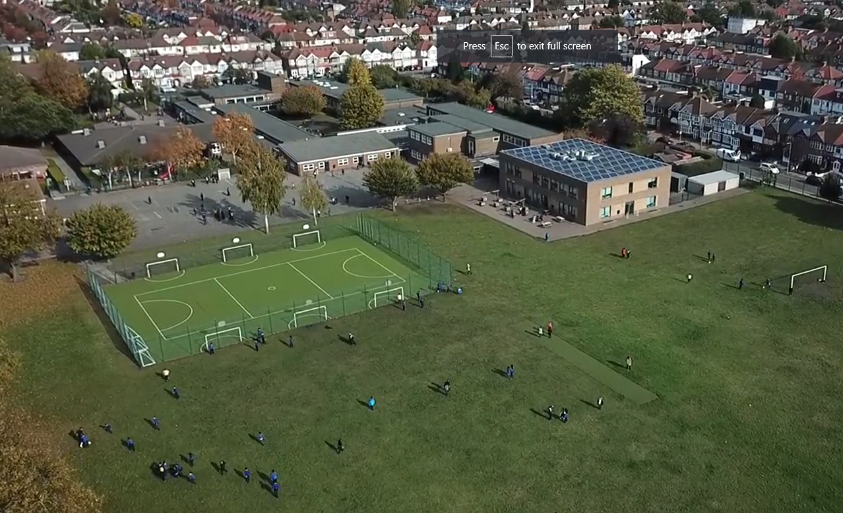
Any questions?
Notes:
Office.Admin: sending out letters, building and analysing surveys, answering queries, advising oveverchanging guidance and answering emails and phone calls
Premises staff: working tirelessly mornings, afternoons, evenings to create safe bubbles, signage, cleaning
LTAs working via zoom with their children, taking resources home to prepare, joining in on zooms
Catering staff: on furlough, Bal agreeing to come in
Fellow SLT: managing remote learning, staff welfare, keeping up with guidance

