Slide 1
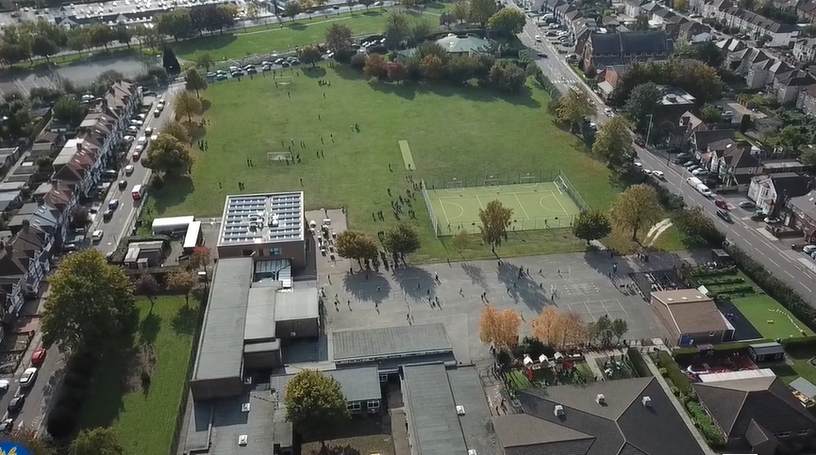
Parent Curriculum Information Year 4 Spring 2024

Slide 2
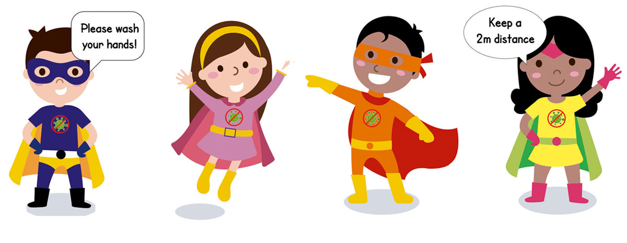
School Vision and Motto
At Barley Lane Primary School it is important that we all work together to ensure that everyone feels happy, safe and ready to learn.
Our School Motto
Believe in yourself, Learn together, Persevere and Succeed

Slide 3
Meeting Outline
1. Welcome
2. Spring Curriculum Topics and Big Question
3. English
4. Maths
5. Science
6. Foundation Subjects
7. Communication
8. Questions

Slide 4
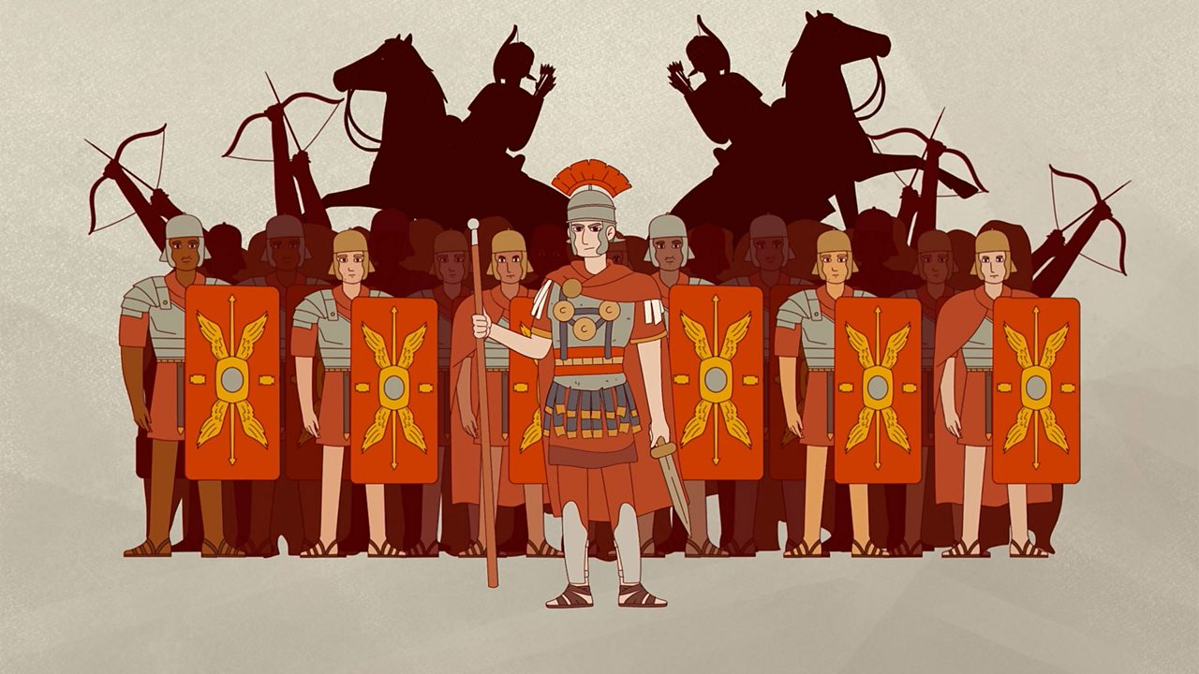
Spring Curriculum Topics
Spring Topic: Ruthless Romans
Big Question: How can we change the world?

Slide 5
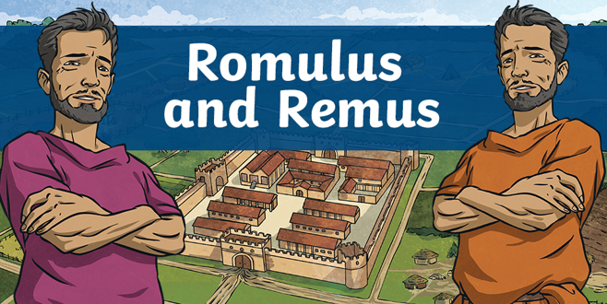
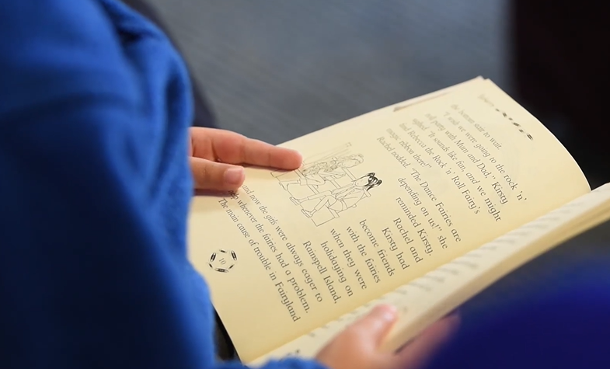
English
Our key texts are:
Writing focus – Roman myths: Romulus and Remus.
The Thieves of Ostia.
The Promise.
Reading focus- Empire’s End: A Roman Story.
Grammar focus- Beginning sentences using fronted adverbials, using expanded noun phrases and using correct punctuation for direct speech including the use of inverted commas.
Speaking and listening – Performing own compositions using correct volume, tone and intonation, opportunities for role play and drama activities and performance poetry.
The key texts link to the topics that we are studying this term. ‘Romulus and Remus’ is a Roman myth about how the city of Rome was founded. ‘The Thieves of Ostia’ is a book that explores the journey of a group of young friends as they solve a Roman mystery. ‘The Promise’ is the tale of a world
where people and nature live in harmony. Using these texts children complete extended pieces of writing including descriptive writing, narrative writing and diary entries.

Slide 6
Maths
Spring 1 - Multiplication, division, length and perimeter
Recall multiplication facts up to 12 x 12
Using factor pairs
Multiply by 10 and 100
Divide by 10 and 100
Using formal written methods to multiply and divide
Multiplying 2 and 3 digit numbers by a 1 digit number
Dividing 2 and 3 digit numbers by a 1 digit number
Measure in metres and kilometres
Calculating the perimeter of rectilinear shapes and finding missing lengths
Calculating the perimeter of regular polygons
Spring 2 - Fractions and decimals
Understanding the whole and counting beyond 1
Compare, order and partition mixed numbers
Understand improper fractions
Convert between mixed numbers and improper fractions
Equivalent fractions
Add and subtract two or more fractions, including mixed numbers
Solve problems involving fractions
Mathematical explanations and reasoning throughout.

Slide 7
Science
Spring 1 – Sound
Vibration and learning about how different instruments make sounds
Exploring the connection between sound and distance
Develop understanding of pitch and volume
Exploring materials that block sound
Develop scientific enquiry questions
Observing, measure, record and identify patterns
Reporting and presenting findings from enquiries, including conclusions
Spring 2 – Electricity
The use of electricity in our every day lives
Investigating circuits and understanding electrical symbols
Effectiveness of different metals in conducting electricity
Planning different types of scientific enquiries to answer questions, including recognising and controlling variables where necessary
Identify scientific evidence

Slide 8
Foundation Subjects
PSHE – living in the wider world and relationships, including the RHE curriculum. Discuss ways of resolving differences, identifying what anti-social behaviour is and how it can affect people, the role of money and beginning to identify ways of managing it, the difference between acceptable and unacceptable physical contact and the importance of keeping personal boundaries and the right to privacy.
Art & DT – In the first half term we will be looking at the artwork of famous Italian artists including Leonardo da Vinci and Michelangelo, with a focus on developing sketching skills. In the second half term, we will be creating our own DT project linking to our topic of the Romans.
RE – People who inspire us, including significant people and religious leaders. Discussing right and wrong, good and bad and knowing the difference between these. Key religious stories from Christianity and making comparisons with other religious beliefs.
History & Geography – The Roman invasion of Britain, characteristics of Roman soldiers including Julius Caesar, exploring why Hadrian’s wall was built and why it was important. Roman architecture including aqueducts and the Colosseum. The religious beliefs of Romans, including gods and goddesses.
Computing – E-safety, meteorologists and bloggers.
Music – A musical journey through sound.
PE – Fitness and circuit training in indoor PE and invasion games in outdoor PE.

Slide 9
Communication with Parents
Homework and spellings are set every Friday on Purple Mash, please support your children in completing their home learning online. Children also have the option of taking a reading book home each week, which they should bring back to school on a Tuesday or Thursday. In addition to supporting your child with their homework, please encourage them to read for at least fifteen minutes each day.
As well as this, Year 4 pupils will be taking a multiplication test in the summer term – this will be an online test. Please support your child in learning their times tables up to 12 on a regular basis.
We hope that this information has given you an insight into our learning for this term. If you have any other questions about the curriculum, please arrange a meeting with your child’s class teacher, this can be done via the school office.
You can also find our Spring Topic Web on the school website, this will provide you with an overview of topics taught.

Slide 10
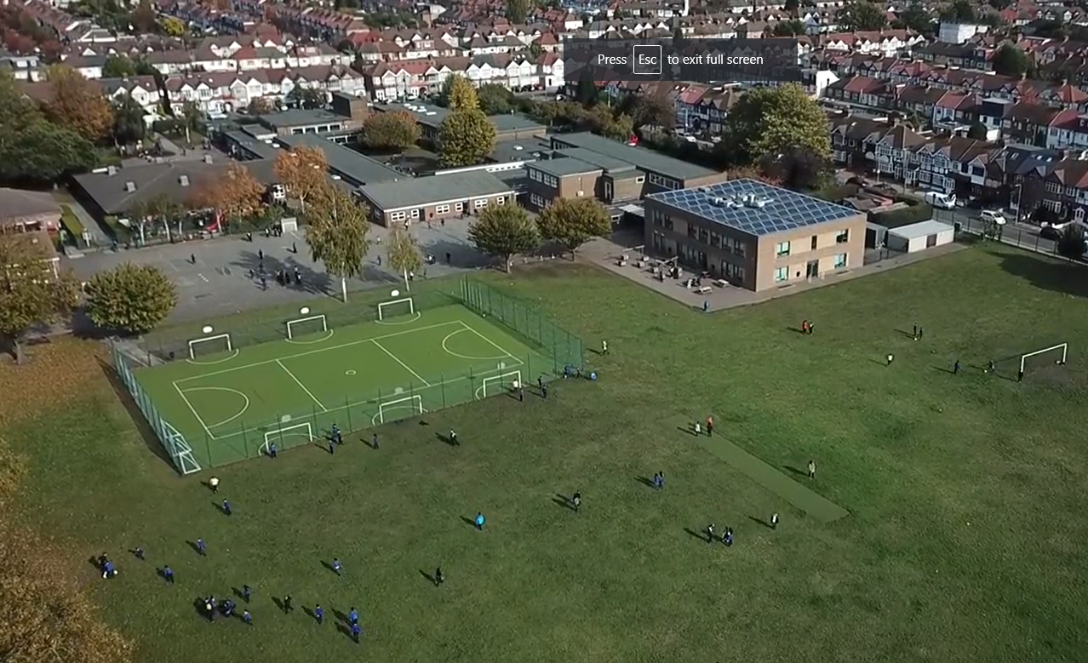
Any questions?
Please do not hesitate to contact us if you have any further questions.
We hope you found the information shared useful.
Thank you for reading.

