Slide 1
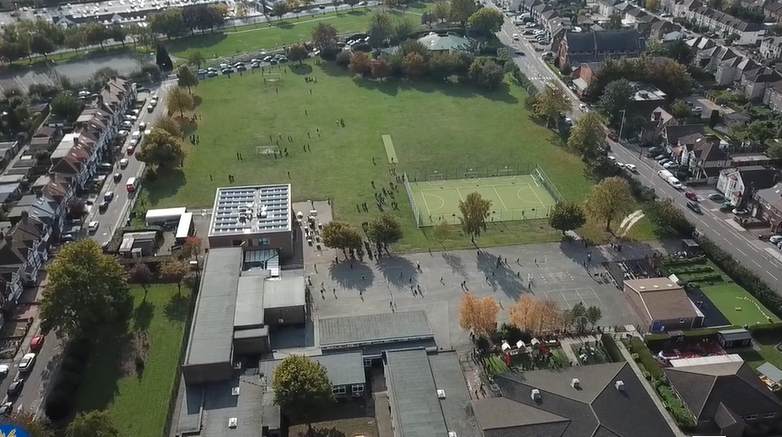
Parent Curriculum Meeting Year 6 Monday 8th January 2024

Slide 2
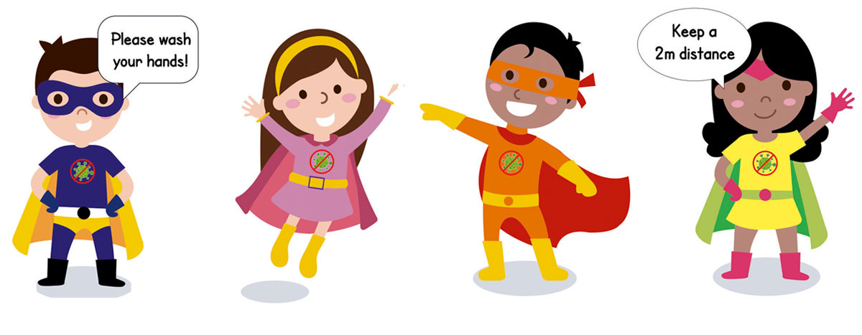
School Vision and Motto
At Barley Lane Primary School it is important that we all work together to ensure that everyone feels happy, safe and ready to learn.
Our School Motto
Believe in yourself, Learn together, Persevere and Succeed

Slide 3
Meeting Outline
1. Welcome
2. Spring Curriculum Topics and Big Question
3. English
4. Maths
5. Science
6. Foundation Subjects
7. RHE
8. Mock SATs week
9. Communication
10. Questions

Slide 4
Spring Curriculum Topics
Spring Topic: Islands
Big Question: ‘Should it always
Be survival of the fittest? '
Notes:
Office.Admin: sending out letters, building and analysing surveys, answering queries, advising ov everchanging guidance and answering emails and phone calls
Premises staff: working tirelessly mornings, afternoons, evenings to create safe bubbles, signage, cleaning
LTAs working via zoom with their children, taking resources home to prepare, joining in on zooms
Catering staff: on furlough, Bal agreeing to come in
Fellow SLT: managing remote learning, staff welfare, keeping up with guidance

Slide 5
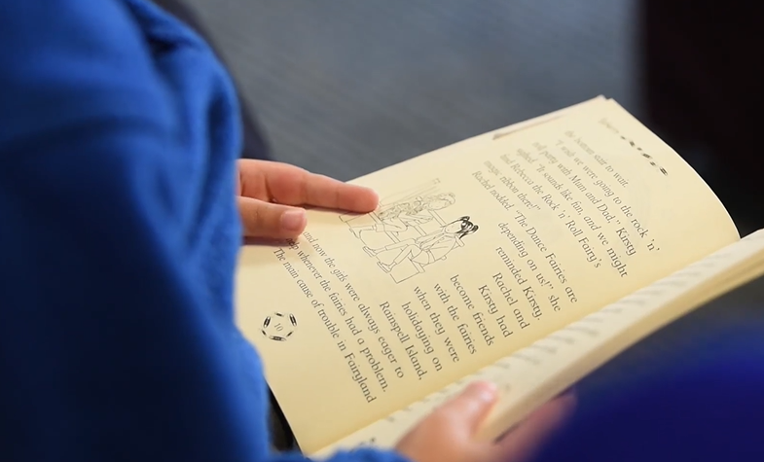
English (Key Learning)
Our key teaching text throughout the Spring Term is the brilliant ‘Kensuke’s Kingdom’ by renowned author Michael Morpurgo. It tells the story of a young boy who is castaway on an island where he discovers many secrets and mysteries….
As you can tell, it fits with the main topic of islands. The main character embarks on a voyage around the world with his parents.
Continuing with our strong pieces from the Autumn Term, this text leads to valuable extended writing tasks. This include formal letter writing (a redundancy letter); persuasive writing (a speech); factual writing (a scientific report); narrative writing (a story about being overboard) and later in term writing in multiple different voices.
Reading skills can also be improved through exploring this text. We will be looking at themes and making comparisons to other similar texts. Furthermore, we will be using inference and deduction to really delve into the character’s psyche and motivation. In additional, we will explore literary techniques such as foreshadowing.
Of course, whilst looking at ‘Kensuke’s Kingdom’ we will be looking at many other texts such as Japanese folktales, diverse poetry, stories such as ‘pig heart boy’ and lots more.

Slide 6
English (Key advice)
Handwriting is a key aspect of the writing assessment framework; we practice regularly in school, but it is vital they practice as much as possible.
Reading regularly is vital to improving reading and writing. We have many books to choose from at school and it is important they read at home.
We will be completing grammar and reading tests throughout the term. As mentioned in the SATs talk at the beginning of the year, please refrain from practicing old SATs papers at home as it prevents us getting a true reflection.
Spelling is an area the cohort need to improve in. It is important that children revise spelling rules as opposed to individual spellings.
This term, we will continue with group teaching though there will be an additional group led by Mrs. Chishty so that more children can receive personalised help.
Lexia will continue before school for selected children. If your child receives a letter inviting them, please try to send them in.

Slide 7
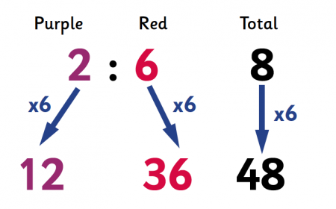
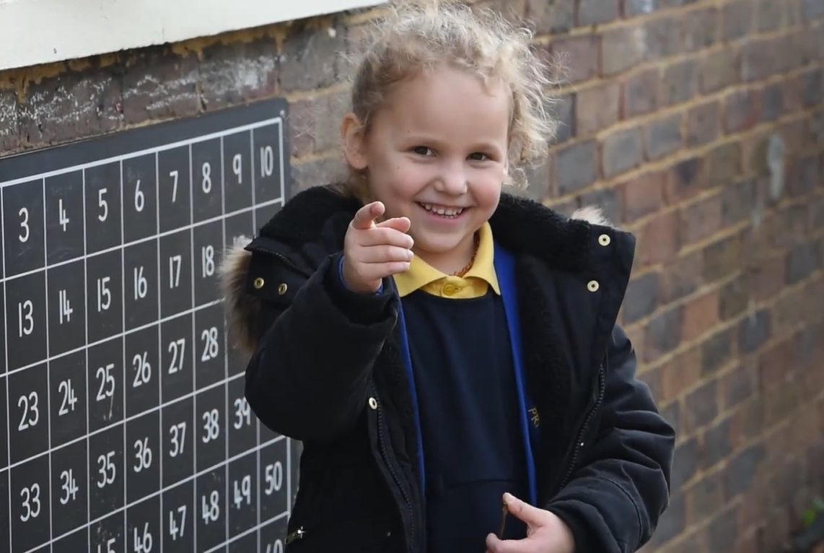
Maths
In the upcoming term, we will be teaching remaining content areas such as ratio (1:2); rotation and translation (when you move shapes on the 4 quadrants); 3D nets and algebra (including the Nth term and missing numbers).
Whilst studying new knowledge, we will also revisit content previously taught in the term such as the four operations, fractions, decimals and percentages, angles and measurement (including area and perimeter).
Some groups, that focused more on fluency, will be taking their knowledge on further this term by exploring more investigative questions, problem solving and questions that require deeper critical thinking.
All groups will have coverage of the 3 branches of maths: fluency, problem solving and reasoning. All 3 are assessed in the SATs and we will be looking at strategies to aid the children in being successful in these branches such as RUCSAC.
As you have seen from the newsletter, vocabulary is a massive part of what we want the children to develop in Barley Lane. The same is true in maths where they need to know and use subject-specific terminology.

Slide 8
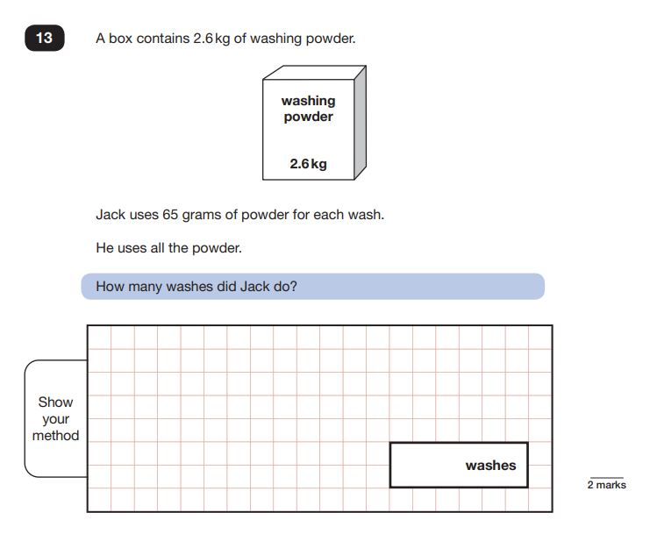
Maths (Key advice)
Like English, we will be completing regular arithmetic and reasoning tests. There will continue to be a heavy focus on arithmetic as number skills are key to success and will be important when transitioning to Year 7.
One of the best ways of improving maths is contextualising it in real life situations; it is important for children to realise how maths skills will help them in the future.
Continue to work on basic knowledge, such as timestables, as these are important for being in successful in other areas such as fractions, percentages, ratio, volume and algebra.
We will continue to teach in groups, including the group led by Mrs. Chishty.

Slide 9
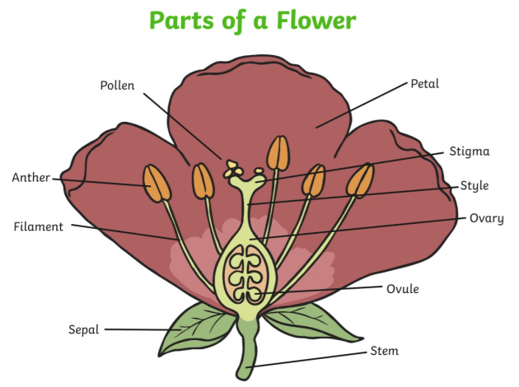
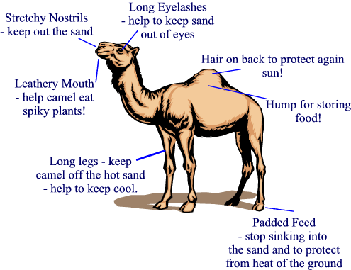
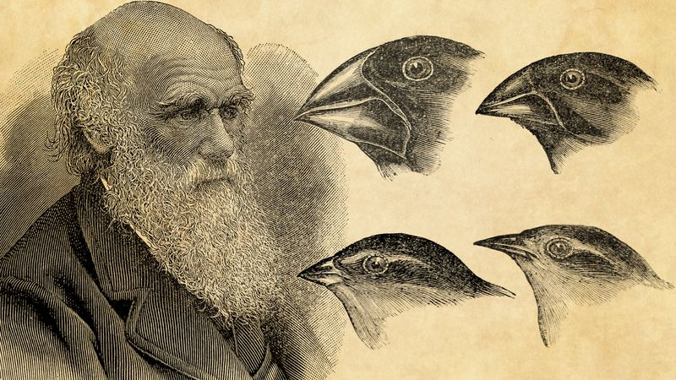
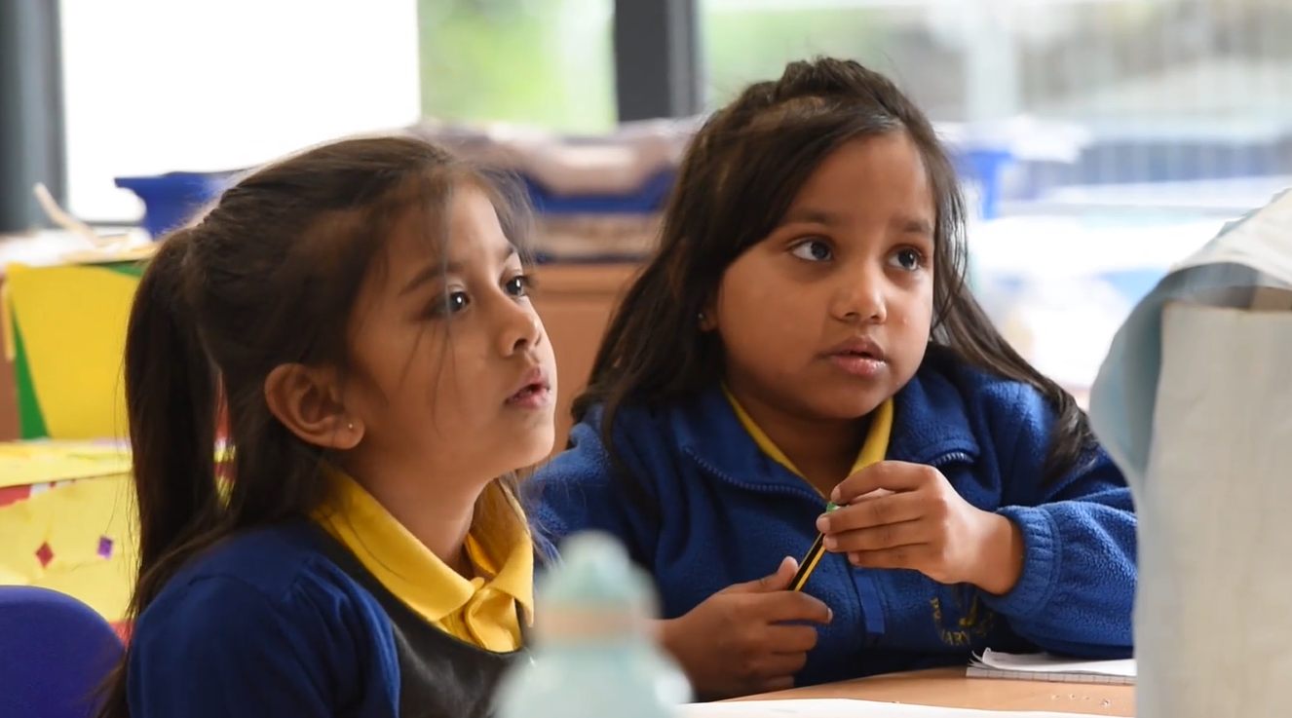
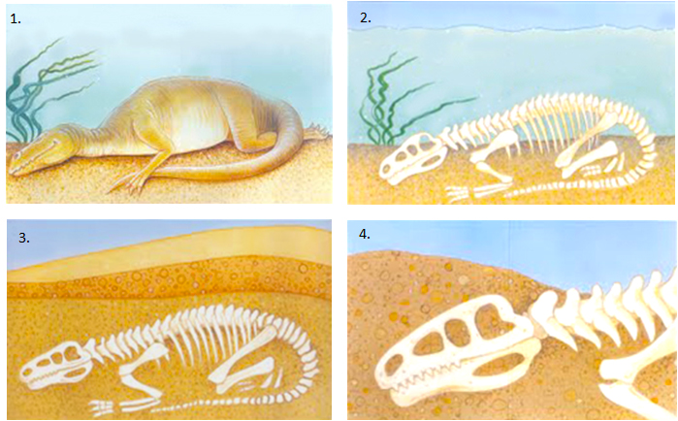
Science
As our key topic is 'Islands' , the areas of science we will be teaching fit naturally with other learning.
This includes:
- exploring the reproductive cycle of plants
- looking at DNA and extracting the DNA from fruits
- understanding the work of Darwin and the theory of evolution.
- investigating the adaptations of animals and how food chains work.
- observing the differences between rocks and understanding the fossilisation process.
- we will be working on ‘working scientifically’ which includes being able to conduct fair tests; make predictions and write conclusions.
Vocabulary, as with all subjects, is important in science and we expect children to use the terminology correctly.

Slide 10
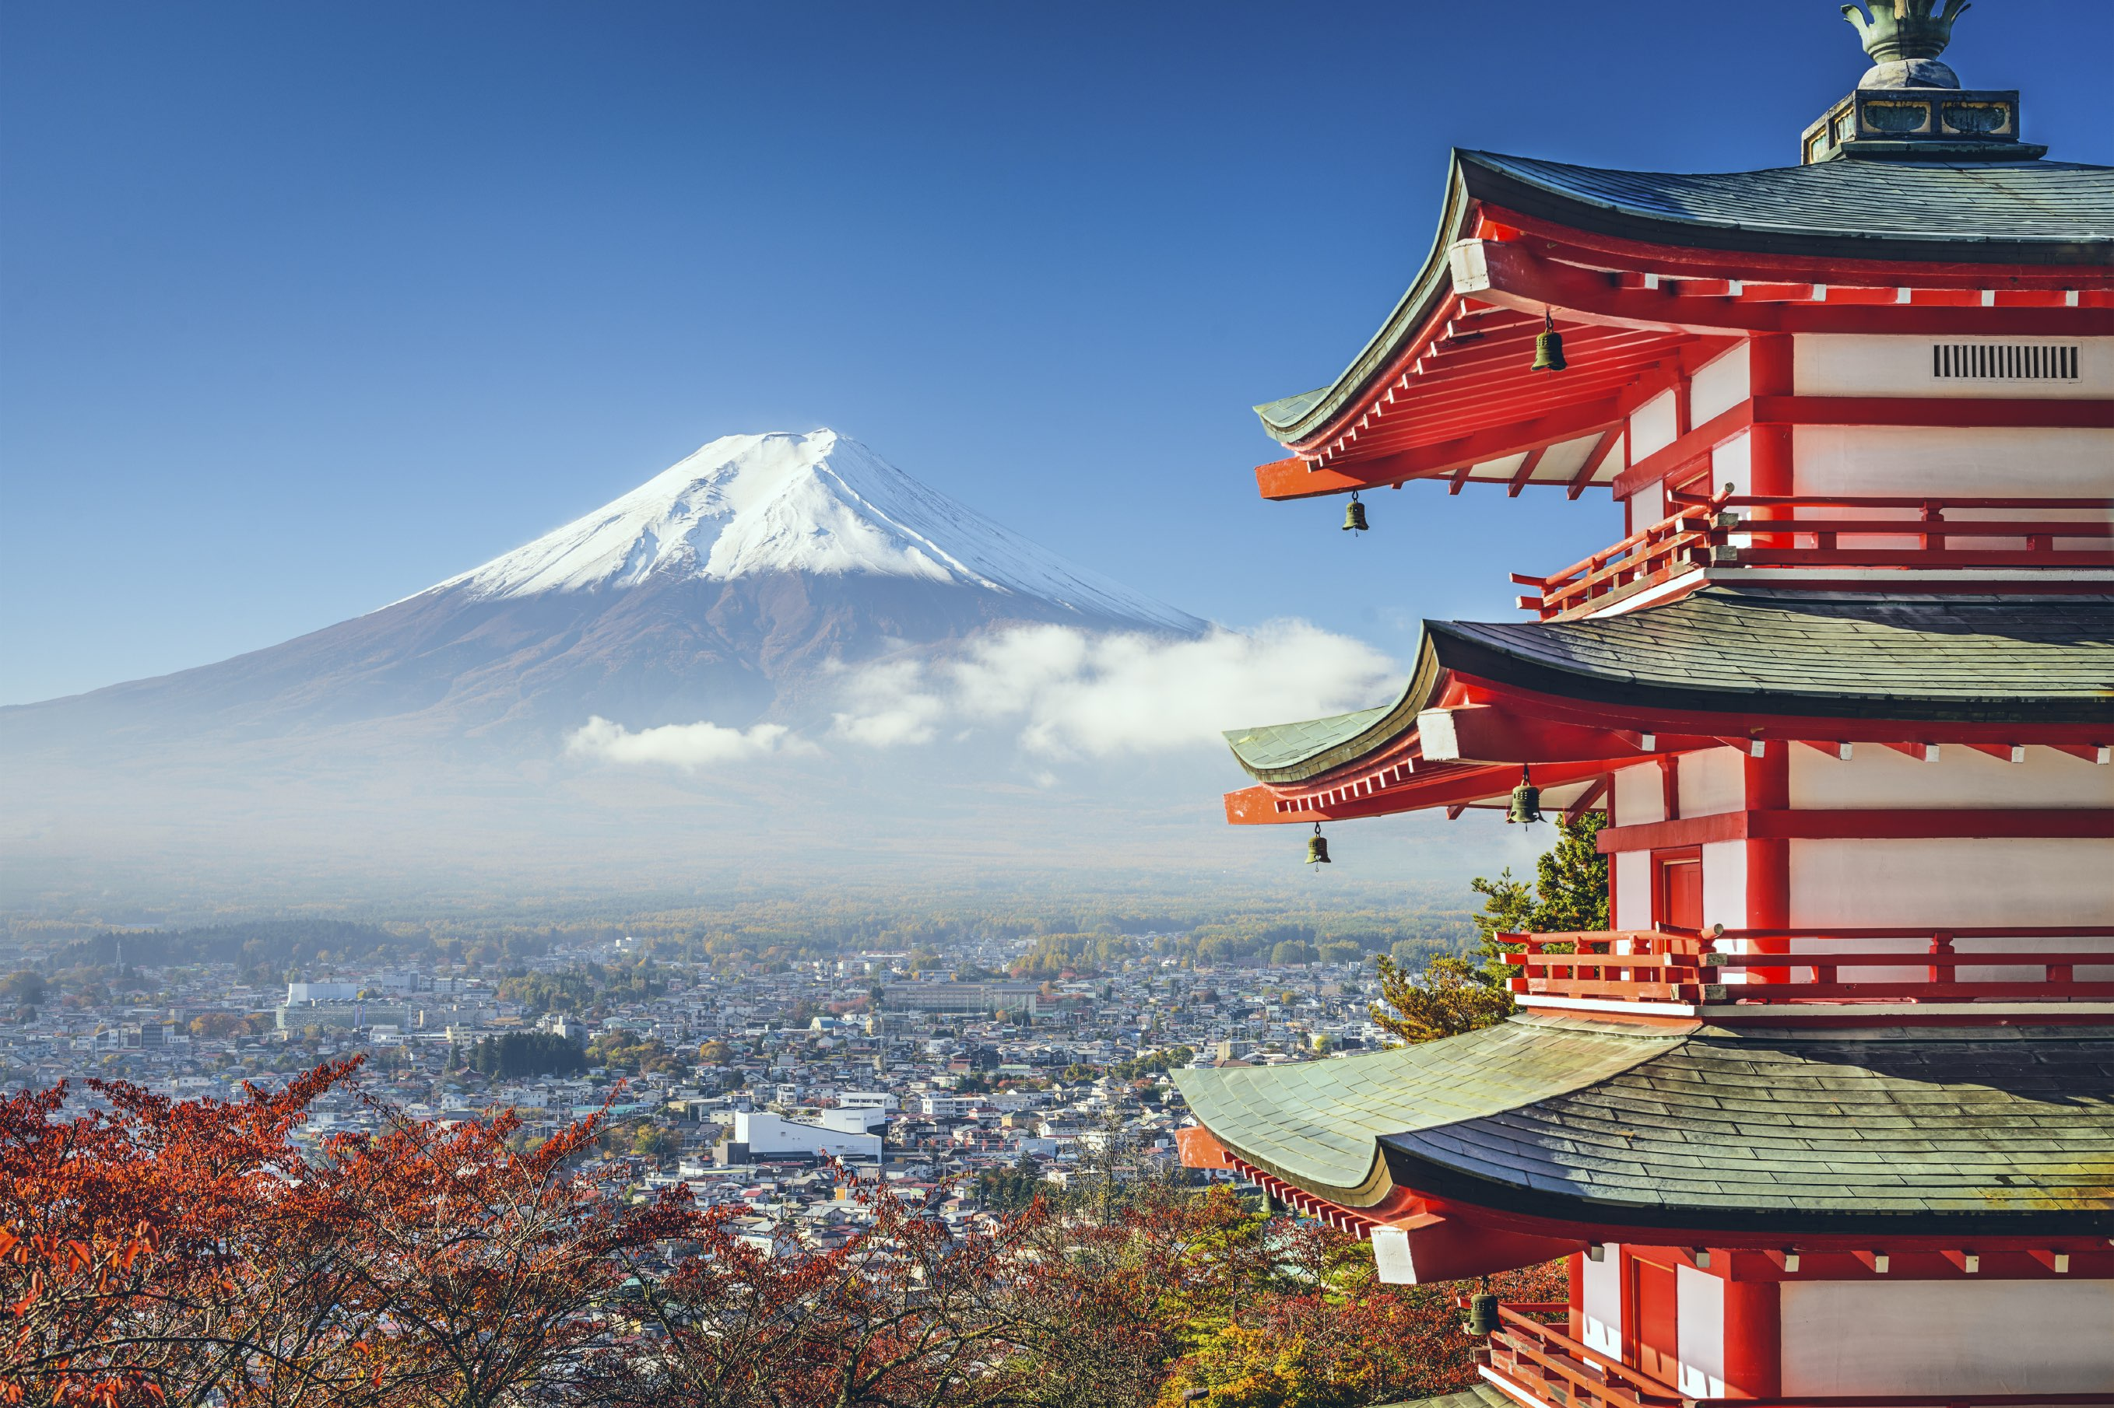
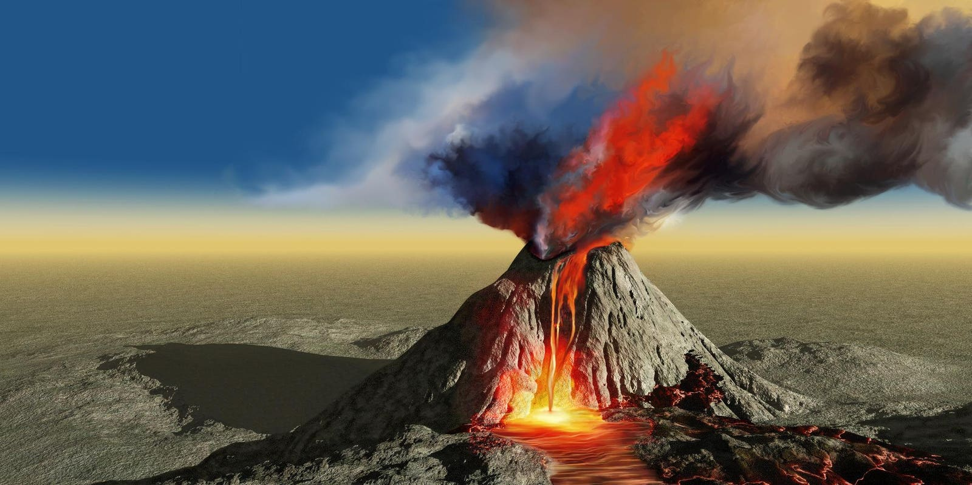
Foundation Subjects
History and Geography
Last term, we had a big focus on history; this term we will be shifting to focus upon geography targets.
We will be looking at volcanoes including the different forms of eruption; the different types of volcanoes; understanding the different parts (such as magma) and looking at the positive benefits of living near a volcano.
We will be looking at geography questions which require critical thinking : e.g, is Mount Vesuvius the most active volcano in the world?
If you visit our classrooms, you will see that Japan is a key thrust of the term’s learning. We will be looking at the physical and human geography of Japan. Furthermore, we will make comparisons between Japan and the UK, and some of our children’s ethnic heritage.
To round off the topic, we will be looking at Japan during World War 2 including some difficult lessons about the atomic bomb in Hiroshima and Nagasaki.
During foundation lessons there will be opportunities for extended writing. It is important that the writing in foundation matches that of their English book. This is significant for when we moderate their writing.

Slide 11
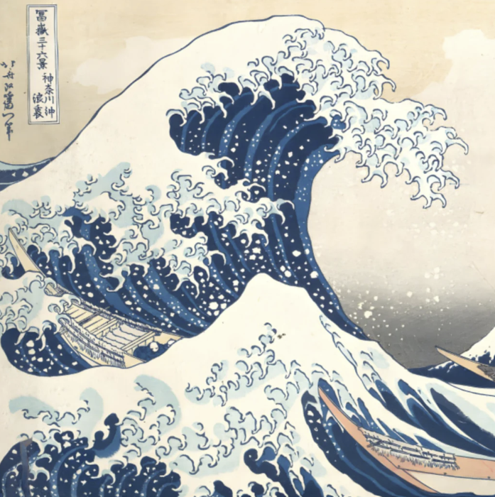
Foundation Subjects
Art and Design and Technology
Life and artwork of Hokusai, including our own sculptures. His most famous work is ‘the Great Wave’ which we will be creating a 3D diorama of.
Exploring the art form of Manga and why it is so popular in Japan and across the world.
Contrasting with diverse artists Hassan Massoudy and Alexis Peskine.
Continue to develop the seven elements of art, ensuring that children use the correct terminology when discussing and evaluating artwork.
R.E - Christianity
Considering life's 'Big Questions', such as 'Is there life after death?’.
Connecting to Science, comparing the religious story of creation and the idea of the Big Bang.
Maturely discussing philosophical questions such as the idea of free will and why there is suffering in the world.

Slide 12
RHE
Many of the RHE topics will be taught through other curriculum areas as opposed to individual lessons. These are the main targets we will be exploring
- positive relationships and understanding that relationships should offer children security as they grow up and develop.
- understanding, and appreciating, that they will have lots of different types of relationships in their life.
- what to expect from a friendship including that they must expect there will be positive and negative moments (this is important before they transition to year 7).
- providing them with the skills and resilience to navigate friendships and understand how to manage both conflict and peer pressure.
- building on work from the Autumn term, recognising who to trust and who not to trust. This includes online relationships. Children have admitted during the previous term about being on apps which are beyond their age rating so we will be completing lots of work on that.

Slide 13
Mock SATs Week Week beginning:12th February
The purpose of mock SATs week is to give the children a taste of sitting assessment tests on consecutive days under the same time constraints as the SATs they will sit in May.
Classrooms will be set up as they will find them in May with the chairs separated out.
The tests will help the children to see themselves which areas they most need to work on. It will also help you to see what areas are most important to revise at home.
The results will assist teachers with consolidating their assessments and honing planning and teaching to revise misconceptions and address gaps in knowledge.
The children will take tests in grammar, spelling and punctuation ; reading ; arithmetic and problem solving and reasoning.
A timetable for the week will be sent out nearer the time, with recommendations for how best to support your children.

Slide 14
Communication with Parents
Hopefully, this curriculum talk has given you an insight into key aspects of your children's learning this term.
Our Year 6 topic web is on the school website as a reminder of the key subject topics.
There will be a parents' evening later in the term to discuss your child’s progress. As your child has been taught in attainment groups you will have the opportunity to talk to your child’s English and maths teacher.

Slide 15
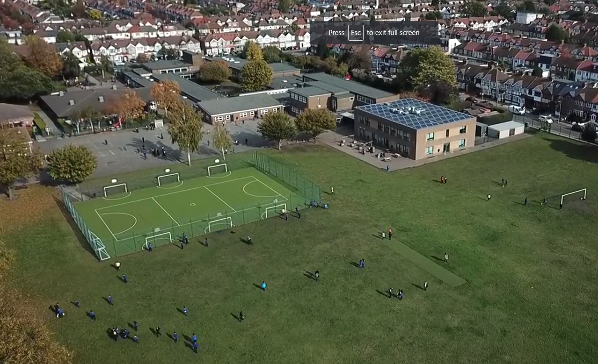
Any questions?
Notes:
Office.Admin: sending out letters, building and analysing surveys, answering queries, advising ov everchanging guidance and answering emails and phone calls
Premises staff: working tirelessly mornings, afternoons, evenings to create safe bubbles, signage, cleaning
LTAs working via zoom with their children, taking resources home to prepare, joining in on zooms
Catering staff: on furlough, Bal agreeing to come in
Fellow SLT: managing remote learning, staff welfare, keeping up with guidance

